Slide 1
What You Need to Know About ABET Accreditation
Maryanne Weiss
Daina Briedis
June 15, 2015

Slide 2
ABET Vision
ABET is recognized as the world leadership in assuring quality and stimulating
innovation in applied science, computing,
engineering, and engineering technology
education.

Slide 3
ABET Mission
ABET serves the public globally through the promotion and advancement of education in applied science, computing, engineering, and engineering technology.
ABET:
Accredits educational programs.
Promotes quality and innovation in education.
Consults and assists in the development and advancement of education worldwide.
Communicates and collaborates with its constituents and the public.
Anticipates and prepares for the changing educational environment and the future needs of its constituents.
Manages its operations and resources in an effective and fiscally responsible manner.

Slide 4
ABET Organization Design
ABET is a federation of 34 professional engineering and technical societies.
Neither institutions nor individuals are members of ABET.
ABET relies on the services of almost 2,200 volunteers supported by 35 full-time and eleven part-time staff.
Notes:
ABET relies on the services of almost 2,200 volunteers supported by 35 full-time and eleven part-time staff.

Slide 5
Member Societies
Represent “the profession”
Develop program criteria
Appoint Board Reps*
Nominate commissioners
Recruit and assign program evaluators
Notes:
Speak briefly about the new governance structure.

Slide 6
ABET’s 34 Member Societies
Notes:
ABET is a federation of 34 professional engineering and technical societies. Neither institutions nor individuals are members of ABET.
A 35th Member Society was approved at the ABET Board of Directors March meeting but has yet to be ratified by the required number of Member Societies.
Represent “the profession”
Develop program criteria
Appoint Board Reps
Nominate commissioners
Recruit and assign program evaluators

Slide 7
Brief ABET History
1932 Engineers Council for Professional Development (ECPD)
established
1936 ECPD first evaluated engineering degree programs
1980 Name changed to “Accreditation Board for Engineering and Technology” (ABET)
1980 Mutual Recognition Agreement (MRA) signed with Canada (1st international agreement)
1989 Washington Accord Agreement signed with Canada, UK, Ireland, Australia, and New Zealand
1994 Policies and Procedures for Substantial Equivalency evaluations (evaluations outside the US) approved
1995 - 2000 Major criteria reform (Engineering Criteria 2000=EC2000)
2006 Substantial Equivalency discontinued
2007 Accreditation of Programs outside the US began

Slide 8
ABET Organizational Structure
Committees
Board of Directors
Accreditation
Council
Industry Advisory Council
Academic Advisory Council
Global Council
ABET
Headquarters
Applied Science Accreditation Commission
Computing Accreditation Commission
Engineering Accreditation Commission
Engineering Technology Accreditation Commission
74 accredited programs at 56 institutions
419 accredited programs at 322 institutions
2364 accredited
programs at 484 institutions
625 accredited
programs at 214 institutions

Slide 9
ABET Board of Directors
5 Officers
President, President-Elect, Past President, Secretary, Treasurer
1-year terms, except for Treasurer who serves for 2 years
41 Directors
1-3 Directors from each member society
3-year term, renewable for additional term
5 Public Directors
Right to vote; no affiliation with member societies
3-year term, renewable for additional term
3 Associate Member Representatives
Privilege of the floor, but no vote

Slide 10
Accreditation in the U.S
Non-governmental
Voluntary
Peer review

Slide 11
What Does ABET Accredit?
An academic program leading to a specific degree in a specific discipline.
Misconceptions clarified:
Not institutions
Not schools, colleges, or departments
Not facilities, courses, or faculty
Not graduates
Not degrees

Slide 12
Who in the U.S. Recognizes ABET?
34 Member & Associate Member Societies of ABET
ISO 9000-2008 certified*
Council for Higher Education Accreditation (CHEA)
State Boards for Engineering & Surveying Licensure & Registration (over 55 jurisdictions)
U.S. Patent Office
U.S. Reserve Officers Training Corps
Council of Engineering Specialty Boards (CESB)
Board of Certified Safety Professionals (BCSP)
Accreditors in other disciplines
U.S. Trade Office
U.S. State Department
Employers (position announcements)
Notes:
Highlight the ISO designation! Just received.

Slide 13
ABET Accreditation Process – What Does It Involve?
Criteria developed by member societies, practitioners, and educators
Self-Study Report by the institution and program
On-site evaluation by peers (from education, government, and industry)
Periodic re-evaluation (maximum 6 years)
Publication of lists of accredited programs

Slide 14
Self-Study Report Basics and Context
Institutions and programs prepare the Self-Study documenting how they comply with ABET criteria and policy
The self-study
Represents the program to the evaluation team
Affords team its first impression of the extent to which the program meets the criteria and policies
Gives an impression of the institution’s preparation for the upcoming visit

Slide 15
Peer Review
Evaluation conducted by team of peer colleagues:
Faculty, industry, and government professionals, and administrators in the profession.
Review the Self-Study Report and conduct the site visit.
ABET resource pool of visitors consists of approximately 2,200 faculty, industry, and government representatives.

Slide 16
Visit Team Members
One Team Chair (or, for large visits, one Team Chair and a Co-Chair).
Typically one Program Evaluator for each program being evaluated (but a minimum of three team members for a single program visit).
Each program evaluator is assigned by the responsible professional society
Possibly one or more observers.

Slide 17
On-Site Visit
Provides direct observation of the institution or programs’ functions and provides the opportunity to interview faculty, students, administrators, and other professional supporting personnel
Complements the Self-Study Report by providing direct, observable evidence that cannot be obtained from the written Self-Study
Team members are volunteers and are not compensated for their work (except for travel expenses)

Slide 18
Accreditation Timeline 18-Month Process
March - June
Team members assigned, dates set, Self-Study Report submitted
May - June
Necessary changes
to statement,
if any, are made
January
Institution requests
accreditation for
programs
December - February
Draft statements edited
and sent to institutions
August
Institutions notified
of final action
Year 1
Year 2
September - December
Visits take place, draft statements written and finalized following
7-day response period
February - May
Institution prepares
self-evaluation
(Program Self-Study Report)
February - April
Institutions respond
to draft statement and return to ABET
July
Commission meets
to take final action
October
Accreditation status publically released

Slide 19
Criteria (Engineering provided here)
Students
Program Educational Objectives
Student Outcomes
Continuous Improvement
Curriculum
Faculty
Facilities
Institutional Support
Program Criteria

Slide 20
Definitions
Program Educational Objectives
Student Outcomes
Assessment
Evaluation

Slide 21
Criterion 1 Students
The quality and performance of students and graduates is an important success factor.
To determine success, the institution must evaluate, advise, and monitor students.
Policies/procedures must be in place and enforced for acceptance of transfer students and validation of courses taken elsewhere.
Assure that all students meet all program graduation requirements

Slide 22
Criterion 2 Program Educational Objectives
The program must have published program educational objectives.
Consistent with the mission of the institution, the needs of the program’s various constituents, and the criteria
There must be a documented and effective process, involving program constituents, for the periodic review and revision of these program educational objectives.

Slide 23
Criterion 3 Student Outcomes (slide 1)
The program must have documented student outcomes that prepare graduates to attain the program educational objectives.
Narrow statements that describe what students are expected to know and be able to do by the time of graduation
These relate to the skills, knowledge, and behaviors that students acquire in their matriculation through the program.

Slide 24
Criterion 3 Student Outcomes (slide 2)
The program must demonstrate that their students attain the following outcomes:
An ability to apply knowledge of mathematics, science, and engineering
An ability to design and conduct experiments, as well as to analyze and interpret data
An ability to design a system, component, or process to meet desired needs within realistic constraints such as economic, environmental, social, political, ethical, health and safety, manufacturability, and sustainability

Slide 25
Criterion 3 Student Outcomes (slide 3)
An ability to function on multidisciplinary teams
An ability to identify, formulate, and solve engineering problems
An understanding of professional and ethical responsibility
An ability to communicate effectively
The broad education necessary to understand the impact of engineering solutions in a global, economic, environmental, and societal context

Slide 26
Criterion 3 Student Outcomes (slide 4)
A recognition of the need for, and an ability to engage in, lifelong learning
A knowledge of contemporary issues
An ability to use the techniques, skills, and modern engineering tools necessary for engineering practice
Plus any outcomes specific to field of study

Slide 27
Criterion 4 Continuous Improvement
The program must use a documented process incorporating relevant data to regularly assess its student outcomes, and to evaluate the extent to which they are being met.
The results of these evaluations of program outcomes must be used to effect continuous improvement of the program through a documented plan. Other information may also be used to assist in the continuous improvement of the program.

Slide 28
Criterion 5 Curriculum (slide 1)
Faculty must assure that the curriculum devotes adequate attention and time to each component, consistent with objectives of the program and institution.
One year of a combination of college-level mathematics and basic sciences appropriate to the discipline
One and one-half years of engineering topics, consisting of engineering sciences and engineering design appropriate to the student’s field of study

Slide 29
Criterion 5 Curriculum (slide 2)
General education component that complements technical content and is consistent with program and institutional objectives
Students prepared for engineering practice through curriculum culminating in a major design experience
Based on knowledge and skills acquired in earlier course work
Incorporates appropriate engineering standards and multiple realistic constraints

Slide 30
Criterion 6 Faculty
Sufficient number to achieve program objectives
Competent to cover all curricular areas of program
Authority for creation, delivery, evaluation, modification, and continuous improvement of the program

Slide 31
Criterion 7 Facilities
Adequate to (safely) accomplish educational objectives and outcomes of the program
CAC: Computing resources are available, accessible, systematically maintained and upgraded, and supported.
EAC: Foster faculty-student interaction; encourages professional development and professional activities; and provide opportunities to use modern engineering tools.
Notes:
What: Classrooms, laboratories and associated equipment, office space, library, etc.

Slide 32
Criterion 8 Institutional Support
Sufficient to attract, retain, and provide for continued professional development of faculty
Sufficient to acquire, maintain, and operate facilities and equipment appropriate for the program

Slide 33
Program Criteria
Each program must satisfy applicable program criteria that may, depending upon the commission, amplify:
Objectives
Outcomes
Curricular topics
Faculty qualifications
Must satisfy all Program Criteria implied by title of program

Slide 34
Master’s Level Programs Criteria*
Fulfillment of baccalaureate-level general criteria
One academic year of study beyond the baccalaureate level
Ability to apply master’s level knowledge in a specialized area related to program area
Fulfillment of program criteria appropriate to master’s specialization area
Develop, publish, and periodically review educational objectives and student outcomes
Notes:
Revised Master’s Level Criteria approved by ABET Board on first reading.
Out in the community for review and comment.

Slide 35
ABET Accreditation Activities
Accredited 3,466 programs at 698 colleges and universities in 28 countries
Non-U.S. Programs
Accredited 420 programs at 87 institutions in 27 countries
Uniform accreditation criteria, policies and procedures used for all visits, regardless of location

Slide 36
Getting Out in Front
Make sure your Program Educational Objectives address the needs of employers and the graduates
Provide a meaningful, periodic review of their relevance
Avoid writing PEOs as Student Outcomes without constituent engagement

Slide 37
Pay Attention to Only the Data Needed
Faculty and/or staff fail to put adequate attention to which data need to be gathered to assess and evaluate, especially for Student Outcomes
Common mistake is to gather many, many more data than needed
Failure to logically evaluate data prevents reasonable, evidence-based conclusion that an outcome is being attained

Slide 38
Faculty Must be Involved
Many large programs hand off all assessment activities to a staff person (some qualified, some not)
Program Evaluators look for faculty knowledge of processes and results
Experience shows that most (preferably all) faculty members must be involved for the requirements of Criterion 4 to be fully met.

Slide 39
Be Prepared… the Program Evaluator Will
Scour the ABET website for useful information available to all who are willing to look
(www.abet.org)
Review Program Evaluator refresher training to find a list of common shortcomings associated with each criterion
(www.abet.org/pev-refresher-training/)
Notes:
Accreditation Alerts

Slide 40
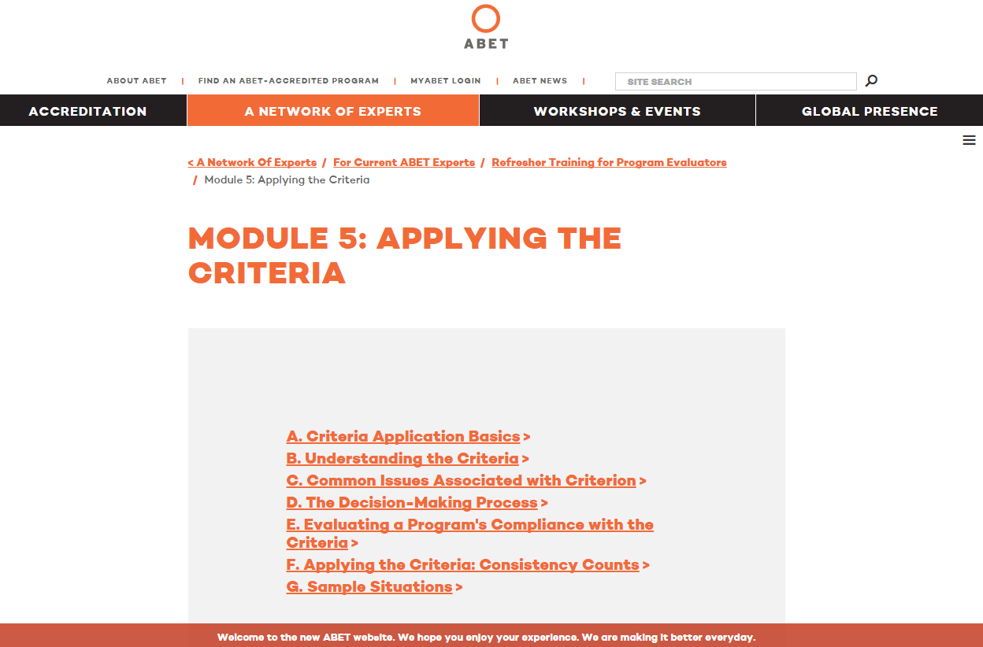
http://www.abet.org/pev-refresher-training-module5/

Slide 41
Be Up To Date… The Team Chair Will
Scour the ABET website for useful information available to all who are willing to look
(www.abet.org)
Review the website Accreditation section to learn about important changes to criteria and Accreditation Policy and Procedure
(www.abet.org/keep-up-with-accreditation-changes/)

Slide 42
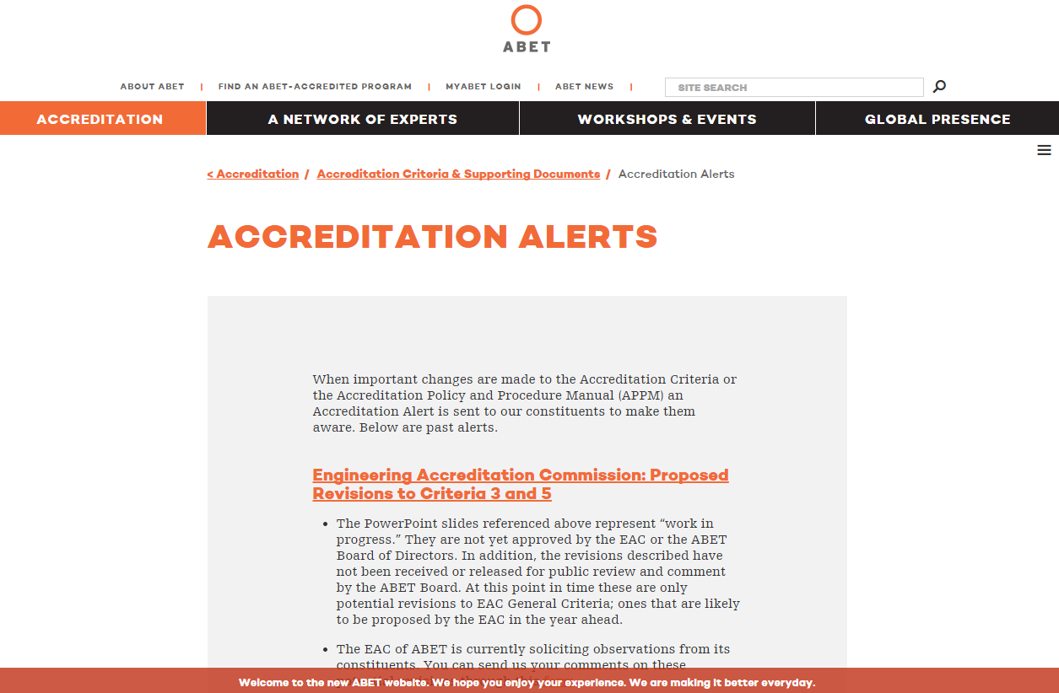
http://www.abet.org/keep-up-with-accreditation-changes/

Slide 43
Notes:
Questions?

