Slide 1

ABET Recognition of Credentials (ROC)
Essential Elements for a Recognized Credential Program
<<presenter>>
July 31 2026

Slide 2
Introduction
The credential landscape is complex and rapidly evolving. There are significant differences among credentials in many ways, such as:
  Terminology
  Structure / packaging (e.g., stand-alone, part of a sequence, stackable, elective paths, …)
  Duration (including such things as contact hours or time limits on completion)
  Delivery (e.g., in-person, on-line, hybrid)
  Assessment and evidence of learning (e.g., exams, performance tasks, portfolios)
Acknowledging that there is no “one-size-fits-all”, this is a summary of key expectations for an ABET-Recognized Credential Program.

Slide 3
Terminology - 1
ABET has developed definitions for key terms to help communicate our intent.
Credential Program
  This refers to any specialized educational program designed to provide expertise to the learner that would typically prepare them with job-ready skills, support alternative career opportunities, enhanced professional skills, or enable career advancement. This includes alternative-to-traditional educational programs sometimes referred to as micro-credentials, stackable credentials, certificates, and similar offerings.

Slide 4
Terminology - 2
Credential Educational Goals – Credential Educational Goals are specific statements that describe what a credential program is preparing learners to accomplish upon being awarded the credential. Normally these goals would be expressed in terms of learner career goals, workforce needs or professional skills.
Learner Outcomes – Learner Outcomes describe what individuals enrolled in the credential program are expected to know and be able to do to earn the credential. These relate to the knowledge, skills and abilities that these learners are expected to acquire as they progress through the credential program.

Slide 5
Foundational Principle – Offeror controls all aspects of the Credential Program - 1
The scope of a recognized credential program includes the complete lifecycle of the program including:
  Conception
  Design, including Credential Educational Goals (CEGs) and Learner Outcomes (LOs)
  Content creation, delivery and learner support
  Continuous quality improvement
  Retirement of the credential program

Slide 6
Foundational Principle – Offeror controls all aspects of the Credential Program - 2
Definition - Subcontractor:
  A subcontractor is an individual or organization that is not part of the credential offeror’s staff but is hired to perform specific work related to the credential program. This might include designing content, delivering instruction, supporting learners, providing assessment services or offering technical or administrative support.
While the offeror may subcontract elements of the credential program, the offeror is responsible for selecting qualified subcontractors and monitoring & controlling the quality of their performance.

Slide 7
Foundational Principle – Truth in Advertising
The basic principle that underlies ABET’s expectations
  Truth in advertising
    Can a prospective learner easily determine what a credential program promises to deliver, what it costs, what is required to earn the credential?
    Does the credential program deliver on its promises?
This basic principle leads to requirements for:
  Consistency of information in all published materials
  Completeness of essential information
  Clear statements of essential prequalification requirements and any required specialized resources that allows the learner to successfully complete the credential program
  Clear distinction from other non-recognized credential programs

Slide 8
Foundational Principle – Stakeholder Engagement
Identify and involve appropriate stakeholders from the targeted workforce, gathering feedback from all learners on program improvements
There may be many types of stakeholders, e.g. employers and learners, although learners are the key stakeholder.

Slide 9
Examples of Types of Services That Do Not Qualify for ABET-Recognition - 1
Stand-alone examinations
  Testing without the educational / training components
Development and distribution of training / educational materials to be delivered by individuals who are not under the control of the offeror.
Credential completion conditions that do not address achievement of Learner Outcomes.
  E.g., a broad test score that does not focus on the LOs.

Slide 10
Examples of Types of Services That Do Not Qualify for ABET-Recognition - 2
An element of a larger educational program, e.g., a course(s) within an academic degree program, for which there is not a dedicated Continuous Quality Improvement (CQI) process focused solely on the element designated as the credential. Specifically, the CQI process for the overall degree program cannot be used for the unique credential program, unless there are components that directly address the Credential Educational Goals and Learner Outcomes for the credential.

Slide 11
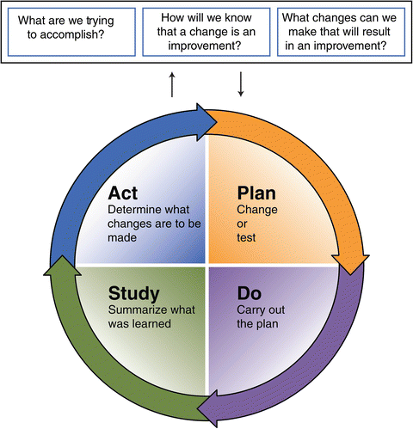
The Basic CQI Cycle
There is a wealth of information on CQI. Here is a link to the American Society for Quality
https://asq.org/quality-resources/continuous-improvement?srsltid=AfmBOop90ANymqXAdhmpntdGodrdWv4S_dPhPJGh8YkTtNAzZAdwB-5K

